Slide 1
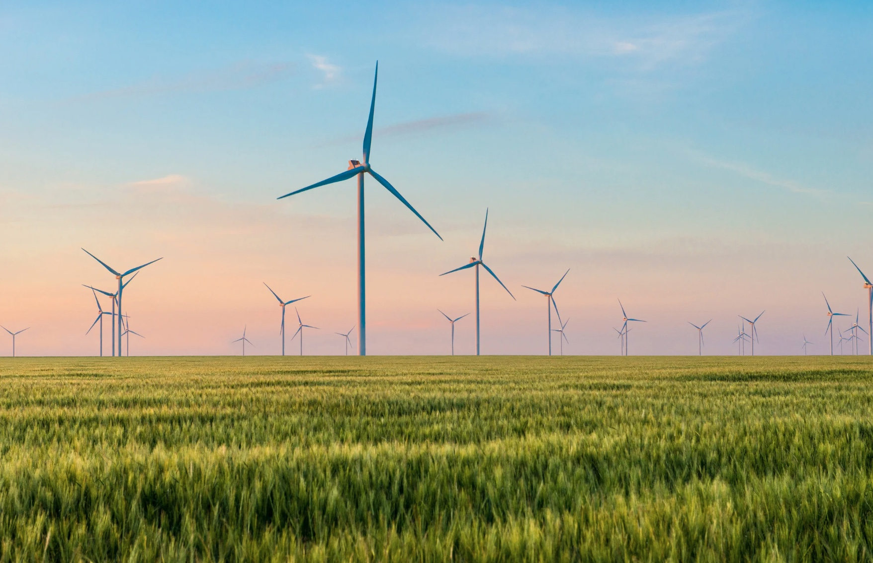
A Short Course on Robust Climate Policy
Module D: Net Zero Roadmap and Investment
Stephen Stretton
Climate Economics
American University, Kyiv
August 2024

Slide 2
IEA (2023), ‘Net Zero Pathway’
‘Ukraine’s Net Zero COP28 Report’ (2023).
CPI (2023), ‘How Big is the Net Zero Financing Gap?’

Slide 3
“Today much of the momentum is in small, modular clean energy technologies like solar PV and batteries, but these alone are not sufficient to deliver net zero emissions... Electricity transmission and distribution grids need to expand by around 2 million km each year to 2030 to meet the needs of the NZE Scenario… Carbon capture, utilisation and storage (CCUS), hydrogen and hydrogen-based fuels, and sustainable bioenergy are critical to achieve net zero emissions; rapid progress is needed by 2030… Increasing clean energy investment in developing countries is vital. The world is set to invest a record USD 1.8 trillion in clean energy in 2023: this needs to climb to around USD 4.5 trillion a year by the early 2030s to be in line with our pathway. ”
(IEA Report, 2023)

Slide 4
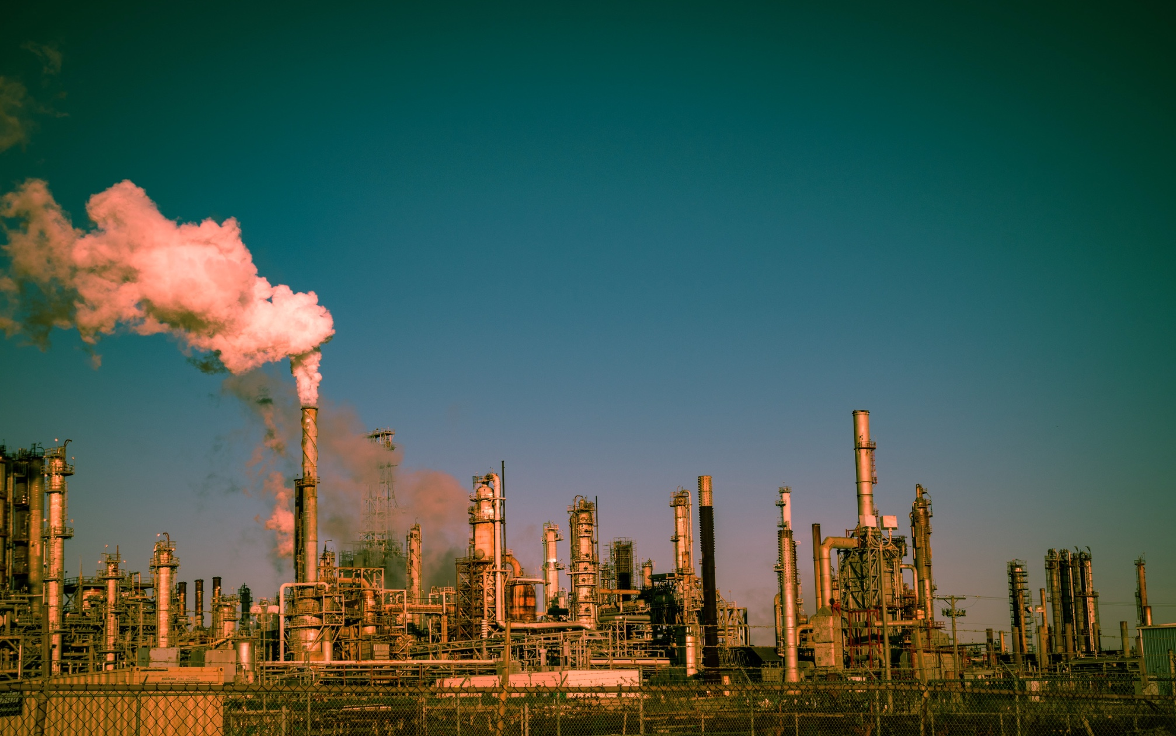

Slide 5
Transitioning to Net Zero
A net zero pathway reduces the physical risks of climate change.
The Pathway involves:
  Increasing RE capacity (3x by 2030, led by solar and wind).
  Doubling the rate of energy intensity.
  Further electrification of end-uses.
  Cutting CH4 emissions from energy.
  Using emerging technologies such as hydrogen and CCS.
  More and varied infrastructure (grids, storage).

Slide 6
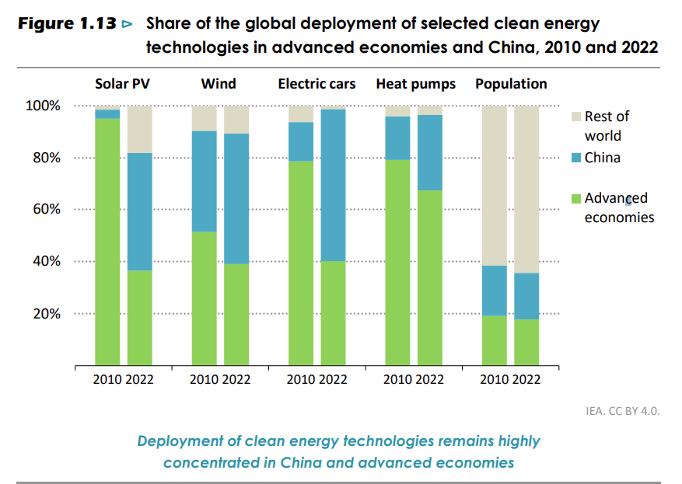
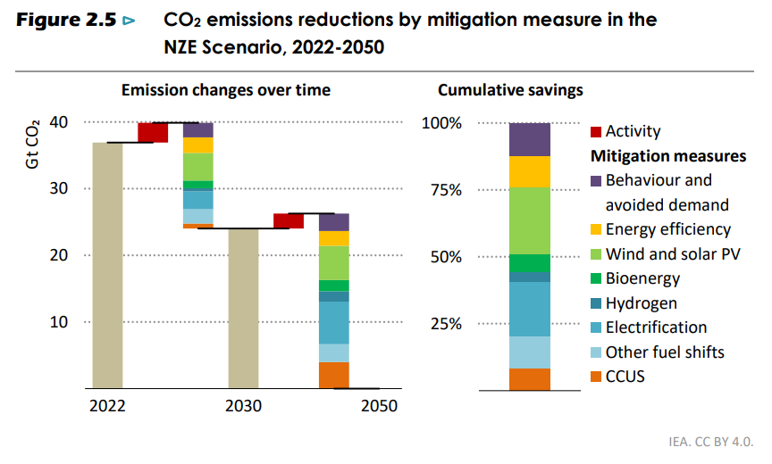
Global Efforts to Net Zero Emissions
Advanced economies take the lead and reach net zero emissions by 2045 in aggregate in the NZE Scenario, China by 2050 and other emerging market and developing economies after 2050.
Mitigation Efforts Distribution to 2050:
  Solar Photovoltaics (PV) and Electrification: 50%
  Efficiency and behaviour change: 25%
  Other technology: 25%

Slide 7
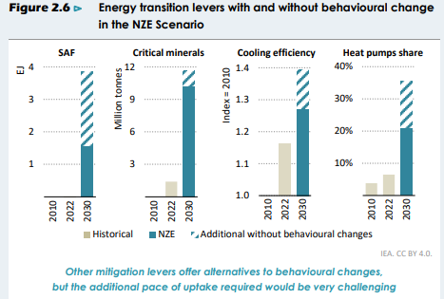
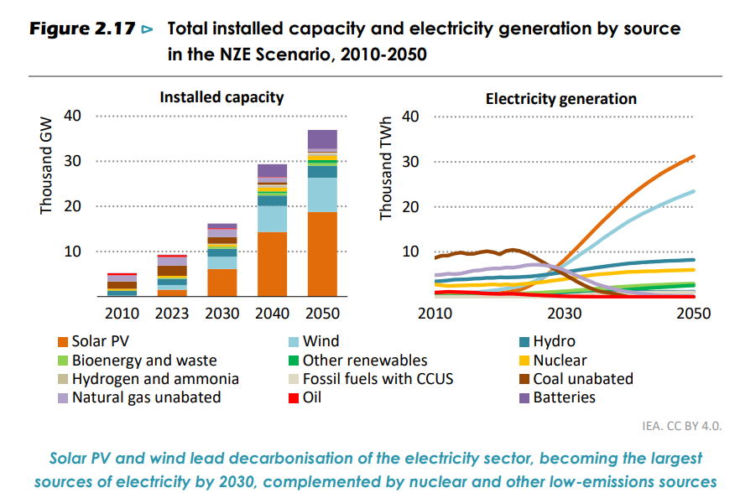
Transition Requirements
  Behavioural changes cut around 1 Gt CO2 from emissions-intensive assets which are still in use in 2030.
  Clean energy investment needs to increase to around $4.5trn a year by the early 2030s, with a particular focus on developing countries.
  Emerging technologies such as hydrogen and carbon capture, utilisation and storage (CCUS) cut emissions mainly after 2030.
  Transmission and distribution grids expand by around 2 million km each year to 2030, and around 30 000 to 50 000 km of CO2 pipelines need to be installed.

Slide 8
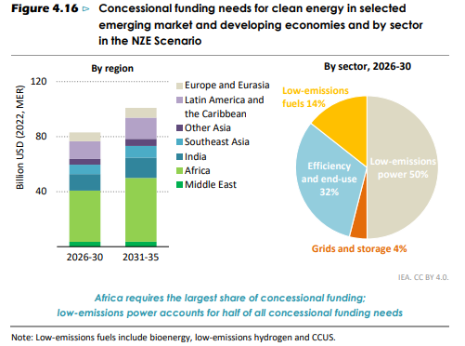
Key Uncertainties around IEA Roadmap
Optimistic techno-economic scenario, which highlights what could be done without political nuance.
  Not enough scenario building around policy actions.
Scenario fails to include LULUCF emissions from agricultural sector which are significant and difficult to abate.
Roadmap relies on energy demand falling 10% compared to 2022, even as economies continue to grow.
  Reliance on behaviour change, which is difficult to predict/ control.

Slide 9
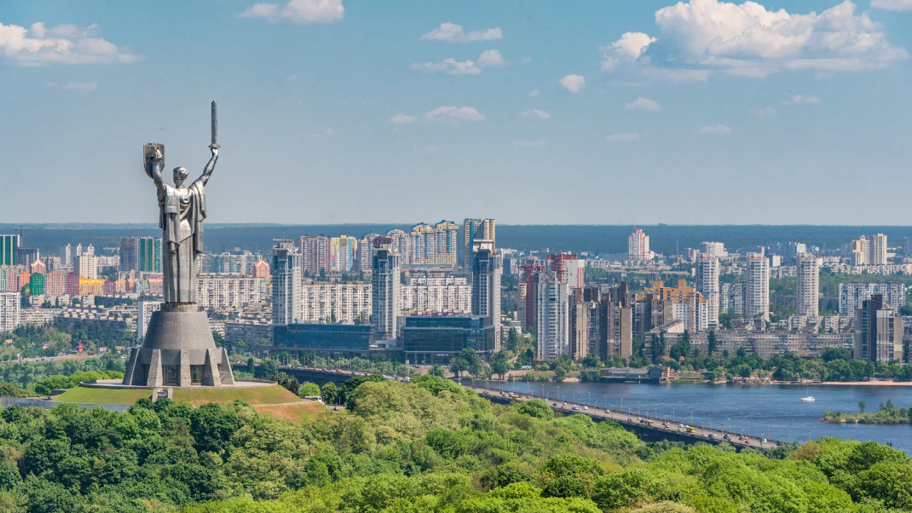
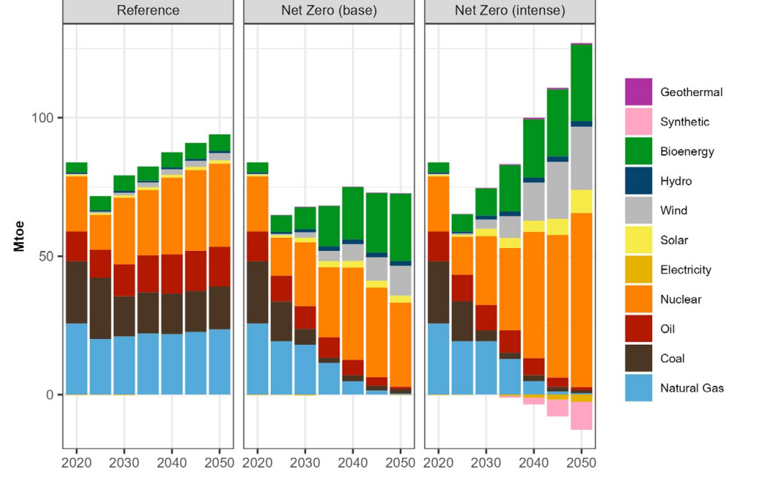
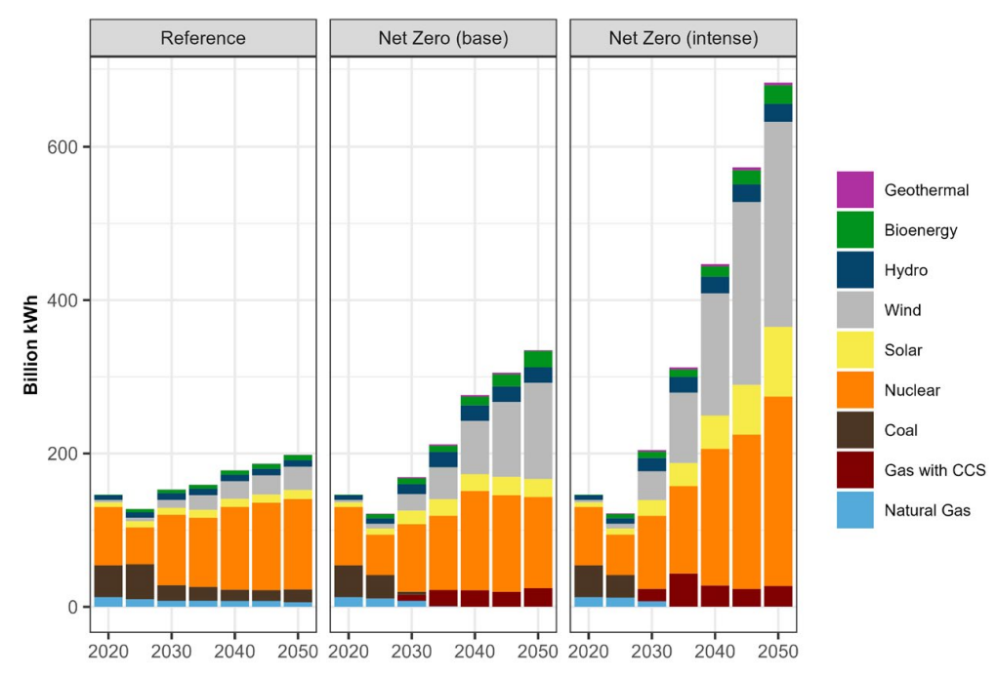
Total Primary Energy Supply
Example: Ukraine’s Net Zero Roadmap
Rapid phase-out of fossil fuels – first coal, followed by natural gas and oil – and increases in wind, biofuels, solar, hydro, and nuclear.
Substantially increased electrification.
Exports of green hydrogen and green electricity begin in 2035 and increase rapidly until 2050.
The 2050 supply mix is roughly half nuclear and half renewables.
Electricity Generation by Technology

Slide 10
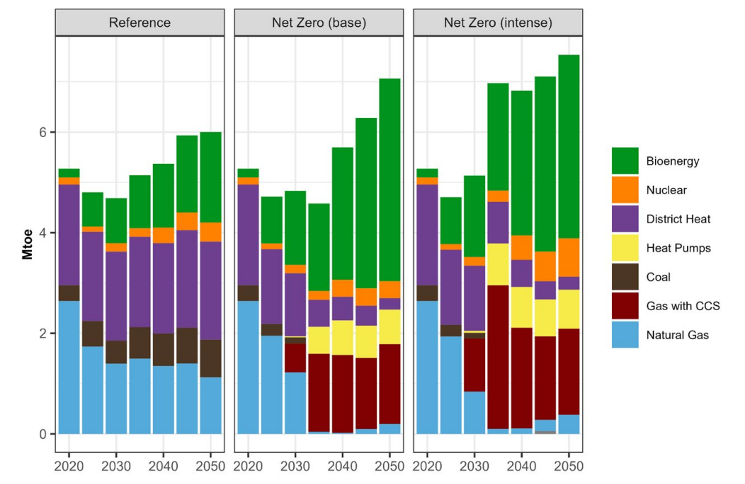
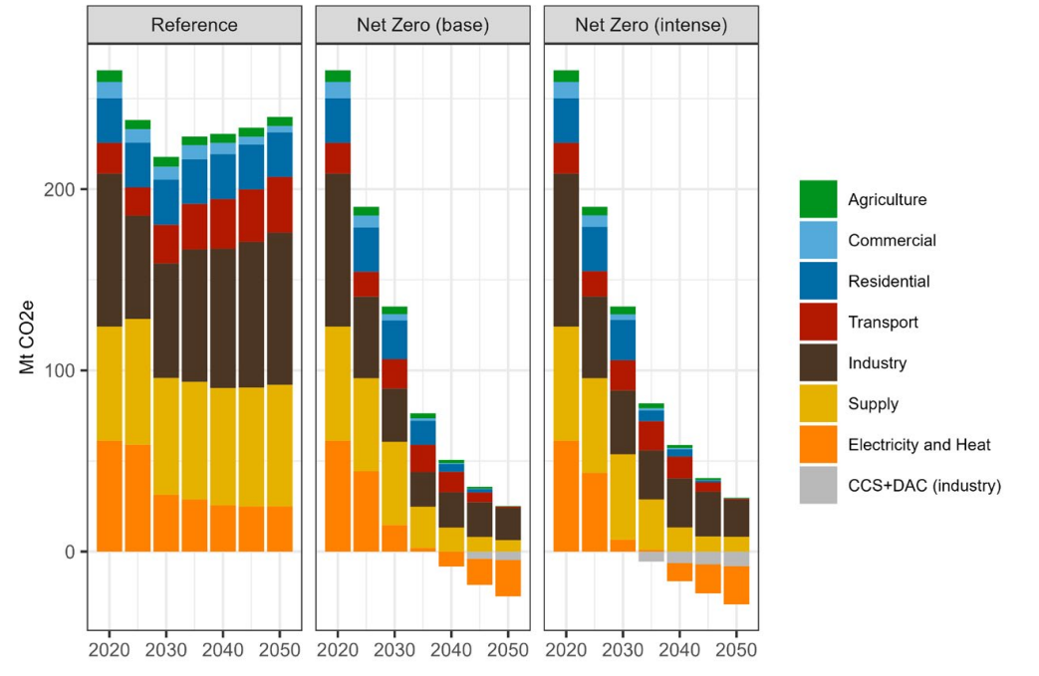
Heat Generation by Technology
Example: Ukraine’s Net Zero Roadmap
The share of bioenergy grows fast between 2030 and 2050, and fossil fuels are replaced by electricity and technologies with CCS systems.
Heat pumps as part of the district heat systems play an important role in decarbonizing the heat sector.
The power sector is decarbonized and becomes net negative in 2040. The buildings sectors reach zero emissions by 2045.
GHG Emissions Projections

Slide 12
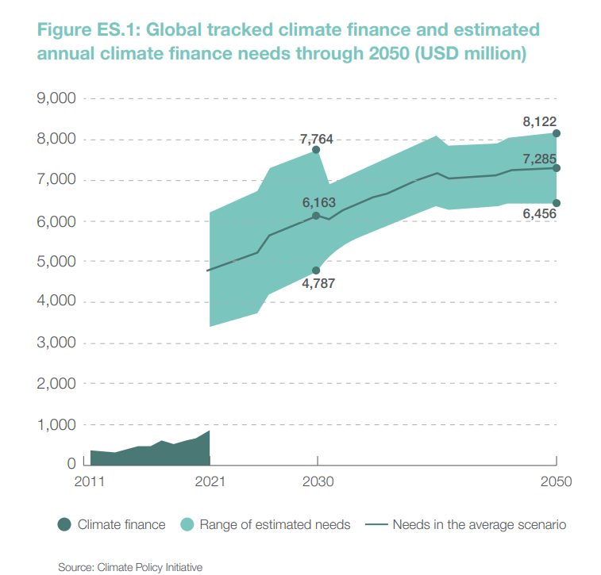
Financing Gap
Massive Investment Required: Achieving net zero globally will require trillions of dollars in investments across sectors, particularly in renewable energy, sustainable infrastructure, and adaptation projects.
Public- Private Finance Balance: The private sector must play a central role in meeting climate investment needs. However, public finance (from developed countries and multilateral development banks) is essential to reduce the cost of capital and attract private investors, especially in higher-risk developing countries.
Long-term Investment Urgency: Many investments, such as in renewable energy infrastructure, are capital-intensive and front-loaded. While policies like carbon pricing support the transition, large-scale investments must be made now to meet long-term climate goals.

Slide 13
Challenges for Developing Countries
High Cost of Capital: Developing economies face significantly higher capital costs due to perceived risks like political instability, weaker regulatory frameworks, and market volatility. This makes it harder to attract private investment.
Limited Policy and Regulatory Capacity: Inadequate policy frameworks and regulatory uncertainty reduce investor confidence. Strengthening these areas is critical to enabling large-scale renewable energy projects and other climate investments.
Debt Constraints: Many developing countries are constrained by debt burdens, limiting their ability to invest in climate projects. Despite this, many mitigation investments offer positive long-term returns, which should be factored into debt sustainability assessments.
Innovation Gaps: Outside of China, developing countries contribute minimally to global clean energy R&D. This underinvestment in innovation creates delays in the adoption of clean technologies, which further slows the transition to low-carbon economies.

Slide 14
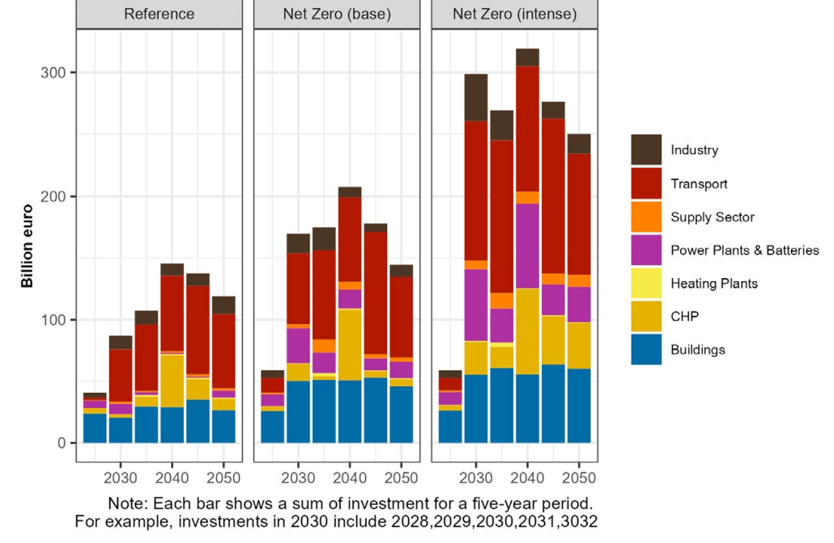
Example: Ukraine’s Investment Needs
Total Investment Needs by Sector
NZ Investment: Approximately 50% higher than the Reference scenario.
Key Areas: Electric and clean-fueled vehicles; Building upgrades; Installation of clean heating systems; New renewable and nuclear power plants.
Estimated at €300 billion for 2028-2032 to meet increased demand for energy services, industrial facilities, and clean power. Gradual decrease as the clean energy economy matures.

Slide 16
Mitigation Investment
Most mitigation investments can generate revenue and be handled by the private sector, but success depends on effective public policy frameworks.
Typical public policy for renewable energy involves renewables auctions for guaranteed revenues. These auctions could be derisked by government.

Slide 17
Mitigation Investment
The needed public policy for investment is more important in developing countries, because of the higher risk level.
Supporting Emerging Sectors:
  Public policies should focus on nurturing emerging technologies ("infant industries").
  As these sectors mature, policies should gradually phase out support for outdated technologies, encouraging a shift to sustainable alternatives.

Slide 18
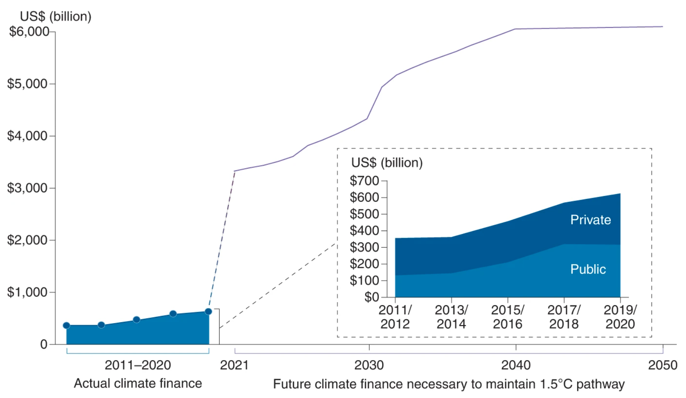
National Financing
Sources of Finance
Public Finance: Government budgets, national development banks, and dedicated climate funds (e.g., Green Climate Fund).
Private Finance: Mobilizing private investment through incentives, risk mitigation, and public-private partnerships (PPPs).
International Aid and Loans: Leveraging international grants, concessional loans, and technical assistance to supplement national efforts.
Average Estimated Annual Climate Investment Need
Source: Meckling et al. (2022)

Slide 19
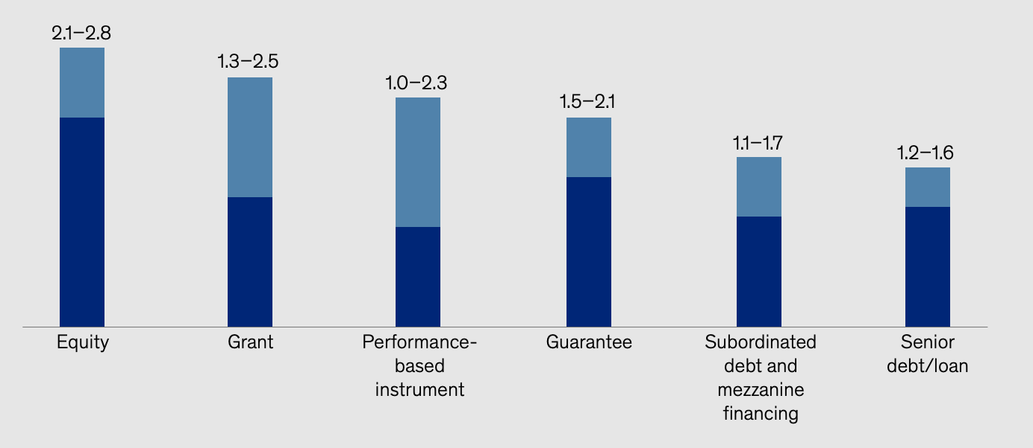
National Financing
Mechanisms for Distributing Climate Finance
Global Leverage Ratios* for Different Financing Instruments
Grants and Subsidies: Direct financial support for clean energy projects, energy efficiency initiatives, and climate adaptation efforts.
Loans and Credit Facilities: Providing low-interest loans or credit guarantees to de-risk investments in green technologies and infrastructure.
Source: McKinsey Sustainability (2023)
*the amount of private sector capital deployment for every unit of public-sector spending.

Slide 20
Innovative Financing Options
Even when governments have limited capacity to borrow or invest directly, innovative financing mechanisms can bridge the gap for climate mitigation.

Slide 21
Innovative Financing Options
Pay-As-You-Go Model: Offshore financing can cover the upfront costs, with governments repaying through fixed annual payments. This approach offers a manageable comparison to ongoing costs like electricity imports or fossil fuel reliance, making the long-term case for investment in renewables.
Sovereign Wealth and Pension Funds: Sovereign wealth funds or pension funds can invest in renewable energy projects. These capital-intensive investments might increase short-term debt but yield long-term GDP growth, with the ability to spread risks across borders.

Slide 22

Ukraine: Sources of Finance Explicit in Roadmap
International Financial Institutions (IFIs) e.g. World Bank, European Bank for Reconstruction and Development (EBRD), International Monetary Fund (IMF). Support through loans, grants, and technical assistance.
Bilateral Donors e.g. Governments of the EU, USA, and Japan. Direct grants and concessional loans for reconstruction and sustainability projects.
Private Sector Investors e.g. Private equity, venture capital, and institutional investors. Investments in green businesses, renewable energy ventures, and sustainable infrastructure projects.
Domestic Contributions e.g. Ukrainian government, state-owned enterprises, local businesses. Public and private investments in infrastructure development, decarbonization, and energy efficiency.

Slide 24
Flexibility and Risk Management
Balancing Debt and Flexibility: While debt limits can seem rigid, there is room for flexibility. Borrowing in USD or alternative currencies helps manage risks, while innovative strategies like blended finance lower financial strain on governments.
International Support and Guarantees: International institutions, such as multilateral development banks, can offer guarantees or co-financing that reduces risk for private investors. This is crucial for attracting large-scale investment in clean energy.

Slide 25
Derisking Investment: Contracts
Contracts specify the payment terms for the power generated by renewable plants, providing financial certainty for investors.
Typically, these contracts are agreements between the energy producer and the distributor (Power Purchase Agreements, or PPAs).

Slide 26
Derisking Investment: Contracts
UK Example:
In the UK, the market’s liberalization led to the adoption of a 'Contract for Difference' model.
How It Works: Producers sell power at market prices, with a contract ensuring that they receive the total amount agreed upon, minimizing market distortions and enhancing market functionality.
Benefit: This model reduces investor risk and ensures that renewable energy targets are met efficiently.

Slide 27
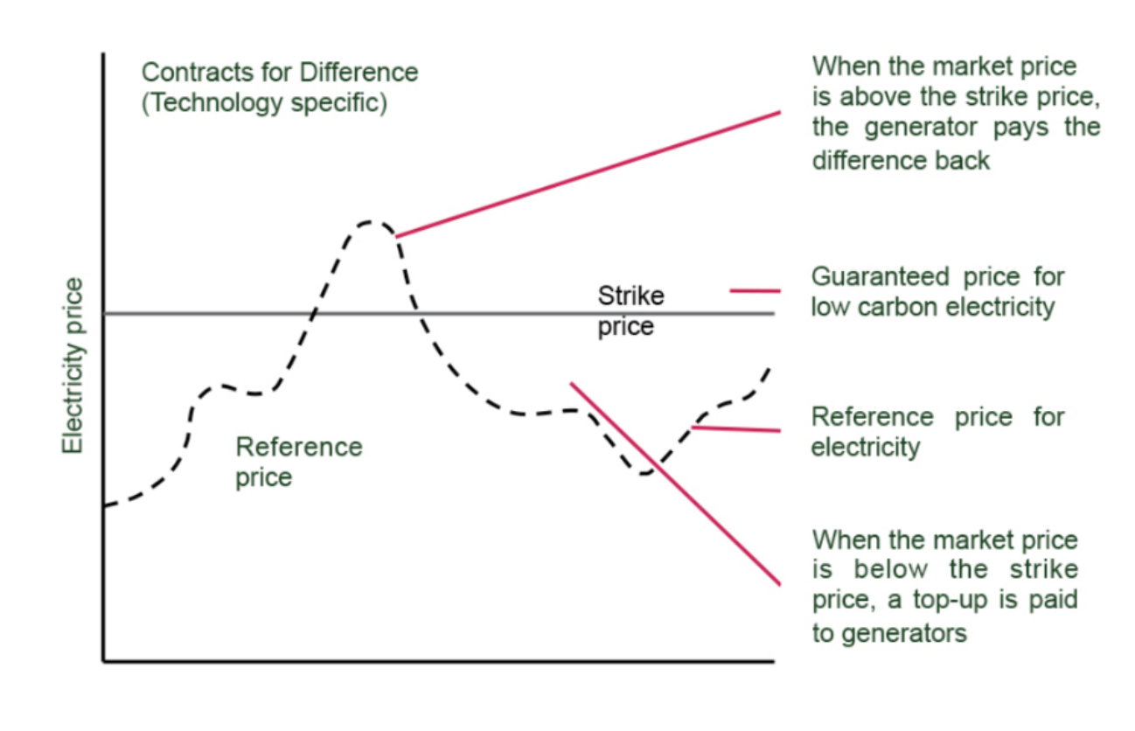
Derisking Investment: Contracts
Contracts for Difference Mechanism Explained
Source: Renewable UK (2019)

Slide 28
Ukraine: Financial Mechanisms Explicit in NZ Roadmap
Concessional Loans
Source: IFIs and bilateral donors.
Mechanism: Low-interest loans with favorable terms and extended repayment periods.
Use: Large-scale infrastructure and energy projects, decarbonization initiatives.
Risk-Sharing Mechanisms
Source: IFIs, including the World Bank and IMF.
Mechanisms: Insurance-based tools and guarantees to protect investments against project risks.
Use: Attract private sector participation by mitigating investment risks.
Green Bonds & Environmental Impact Bonds
Source: IFIs, government bodies, and private sector investors.
Mechanism: Bonds issued to raise capital for environmentally sustainable projects, with returns linked to project outcomes.
Use: Financing renewable energy, energy efficiency, and sustainable infrastructure.
Grants
Source: International organizations, bilateral donors.
Mechanism: Direct financial support without repayment obligations, typically for early-stage or critical projects.
Use: Renewable energy projects, grid upgrades, and emergency response.
Sustainable Development Funds
Source: Contributions from international and domestic stakeholders.
Mechanism: Pooled investment funds supporting public and private sector decarbonization efforts
Use: Projects aligned with Ukraine’s green recovery strategy.

Slide 29
End of Module D

